Slide 1
Database Connectivity

Slide 2
Database
A collection of related data is called database.
A database model gives an explanation about the organization of data in a database.
Once a database is created, then the following operations can be performed on the tables of the database:
Save data into table
Retrieve data from table
Update data of table
Manipulate data of table
Delete data from table

Slide 3
JDBC
A component that gives access to the database to Java applications is JDBC.
JDBC is used to connect enterprise component to any data source.
JDBC is the standard API to work on data source, retrieve the data in tabular format from any kind of data source.
A data source can be relational database, spreadsheet, or flat file.

Slide 4
JDBC
JDBC is a unified standard API that facilitates you to access any data source in tabular format.
JDBC API allows the programmer to write an application with the separation of the underlying architecture and operating environment.
JDBC in a nutshell performs all the database operations related methods, connecting methods, process database results and also support heterogeneous environment.
It provides an interface that has intelligence how to communicate with a proprietary database.
JDBC is same as ODBC (Open Database Connectivity) standard that facilitates the programmer by giving the interoperable function through JDBC-ODBC bridges

Slide 5
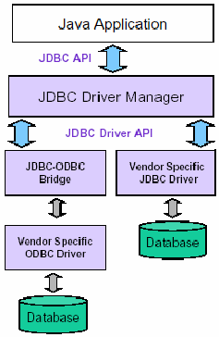
General Architecture

Slide 6
JDBC vs ODBC
JDBC is a set of Java API for executing SQL statements.
ODBC is a set of C API for accessing relational DBMS.
JDBC is a collection of classes and interfaces that facilitate to access the database easily and perform operations on the database.
Just by using few methods calls, we can easily interact with database.

Slide 7
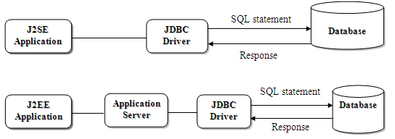
Types of JDBC Drivers
JDBC drivers work as middleware layer between the
application of either type and data source.

Slide 8
JDBC-ODBC Bridge – Type 1
It uses the ODBC as the prime interface to data source.
In JDBC-ODBC Bridge, the client makes the JDBC calls.
The type 1 driver provides a bridge between the JDBC API and the ODBC API.
The bridge is responsible to convert the JDBC calls to the corresponding ODBC calls, and finally request to data source using ODBC libraries, that must be required on client tier.
J2SE contains the classes for the JDBC-ODBC Bridge and so that there is no need to install any other packages.

Slide 9
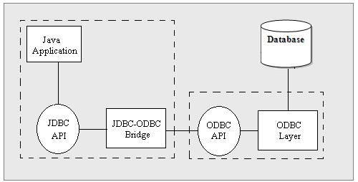
Type-1 Driver

Slide 10
Native-API Partly Java Driver – Type 2
Type 2 driver works on a combination of vendor-specific and Java implemented APIs to communicate with data source.
Here, the client makes the JDBC calls and these calls are interpreted into vendor-specific APIs, finally from vendor-specific APIs to database to perform the operation on it.
Database process the request and send the results back through the vendor-specific API, which will forwarded back to the JDBC driver.
Now, here JDBC driver will convert the response (results) to the JDBC standards and send to Java application.
The driver can be used where there is the need of high-performance and large transaction volume.

Slide 11
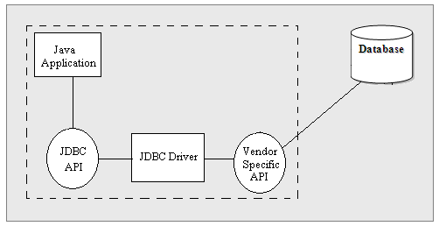
Type-2 Driver

Slide 12
JDBC-Net Pure Java Driver – Type 3
Type 3 driver works as middleware server between a numbers of Java clients to multiple vendor databases.
Type 2 is a multitier and vendor-neutral driver.
To connect with database server, Java client application uses a server component in-between the client and database, that works as gateway for multiple database servers.
The client application sends the request to intermediate data access server, by making the JDBC call through a JDBC driver.
The intermediate data access server completes the request to the Database using native driver.

Slide 13
Type-3
Different protocols are used at different level of communication.
Client and intermediate server use different protocol, and based on the vendor of middleware server, similarly middleware sever connect and communicate with database server by using different native protocol.
There is no need of any driver at the client machine.

Slide 14
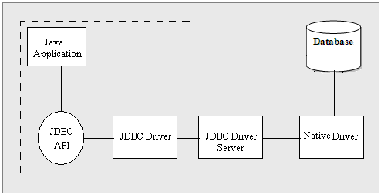
Type-3 Driver

Slide 15
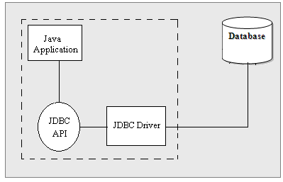
Native-protocol Pure Java Driver – Type 4
Type 4 drivers converts JDBC API request directly to networking protocols of vendor-specific.
By making the socket connection with database they communicate with database.
There is no need of other libraries or any middleware interface to deploy it.

Slide 16
Structured Query Language
SQL Commands are divided into the following categories:
Data Manipulation Language (DML): DML commands work on data, and perform operations like, retrieving it; manipulate it. A brief discussion about the more common DML commands are as follows:
SELECT
INSERT
DELETE
UPDATE
Data Definition Language (DDL): DDL commands use to define the database, like creating the table, modifying the table structure, creating views; and indexing the database. Let’s have a look on more common use of DDL commands as follows:
  CREATE TABLE
  DROP TABLE
  ALTER TABLE

Slide 17
Basic JDBC Programming Concepts [INTRODUCTION TO JAVA.SQL PACKAGE]
The classes in the java.sql package can be separated into the subsequent groups based on their functionality:
Management of Connection
Access Database

Slide 18
Management of Connection
The classes and interface related to connection management let you create a connection to the data.
java.sql.DriverManager: The class offer the functionality essential for running one or more database drivers, individual driver connects to specific database.
java.sql.Driver: The interface abstracts the connection protocol of specific-vendor.
java.sql.Connection: It abstracts the interaction with the database. Sending SQL statement to database, read the results of operations is done by this interface.

Slide 19
Access Database
After creating connection with the database, these types
of classes and interfaces allow you to send SQL
commands (statements) to the database for execution,
and also read the response (result).
java.sql.Statement: The interface allow you to execute SQL commands above the connection and access the results.
java.sql.ResultSet: The interface store the results of execute SQL SELECT commands. To access the results row-by-row, it provides some methods.

Slide 20
Metadata of Database
Metadata is some data about the database. JDBC API supports the facility to retrieve metadata of the database, also parameters to statements; and result too.
java.sql.DatabaseMetadata: The instance of this interface can be obtained by java.sql.Connection. This is used to get information about the features of database.
java.sql.ResultSetMetadata: Methods are provided by this interface to access metadata of java.sql.ResultSet.
java.sql.ParameterMetadata: The interface permits you access the database types of parameters in prepared statements.

Slide 21
Exceptions and Warnings
The collection of classes support the runtime exception
and warning related to JDBC.
java.sql.SQLException: Handle all type of exception of JDBC related, database level, driver level exceptions and error levels.
java.sql.SQLWarnings: It represents database warnings.
java.sql.BatchUpdateException: Handles the exception for batch updates.

Slide 22
Steps of connectivity:

Slide 23
Overview of Querying a Database With JDBC
Connect
Query
Process
results
Close
Notes:
Steps to Querying a Database with JDBC
The slide shows the four main steps to querying a database with JDBC. The following slides explain each step in detail.
The JDBC Package
Your Java class must import java.sql.* to be able to use the JDBC classes.

Slide 24
Stage 1: Connect
Connect
Register the driver
Query
Connect to the database
Process
results
Close

Slide 25
Loading the Database Driver
The concept of a URL in JDBC is same as used other application
like internet.
In basic concept of JDBC URLs, in application more then one
database can be in use, each will be accessed via a different database
driver.
In such a situation, it is necessary every driver must be uniquely
identified.
To communicate with the data source, you must load a driver.
The syntax to load the driver is given below:
Syntax: Class.forName( “DriverClassName”);

Slide 26
Opening Connections/Establishing a Connection
DriverManager class defines object to connect application to a JDBC
Driver. It has a method getConnection() used to find a connection to
a database.
It receives a URL, the URL contains protocol, sub-protocol, sub-name,
and other attribute as well, and returns the connection object.
A Connection object represents a context. SQL statements are fired on
it and return the results. You can create more then one connection in an
application with one database, can have many connection with many
databases.
URL Syntax: jdbc: <subprotocol>:<subname>
Each driver supports it’s own sub-protocol, and each sub-protocol has
its own syntax, varies on the base of number of attributes.

Slide 27
Syntax for loading drivers & establishing connection
Syntax:
Class.forName(“Driver Class Name”);
E.g. Class.forName (“sun.jdbc.odbc.JdbcOdbcDriver”);
Creating Connection:
Connection conn = DriverManager.getConnection(“jdbc:odbc:MYDSN”);
Connection conn = DriverManager.getConnection(urlString,
userName, password); // username and password are optional

Slide 28
Stage 2: Query
Connect
Query
Create a statement
Process
results
Query the database
Close

Slide 29
Creating Statement
Once the connection has been established with data-source, we can
interact with database.
Connection object use to execute SQL statements by creating
Statement, those objects are abstract SQL commands.
Once we create object on one of these statements, we can execute
the statement and read the results, though the result can be stored
in java.sql.ResultSet object if SQL command is SELECT.
The methods are given below to create either type of these
Statements.
Statement createStatement() throws SQLException
The method creates a Statement object, which use to send the SQL
command to the database.

Slide 30
How to Query the Database
1. Create an empty statement object.
2. Execute the statement.
Statement stmt = conn.createStatement();
ResultSet rs = stmt.executeQuery(statement);
Notes:
How to Query the Database
The slide shows the syntax for the three methods that execute a database query.
executeQuery() returns a ResultSet object containing the results of your query.
executeUpdate() returns an int containing either:
The row count, for an insert, update, or delete statement
0, for a statement with no return value, such as a SQL DDL statement
execute() returns true if the result of the statement is a ResultSet, false if the result of the statement is an update count. You can then call either getResultSet() or getUpdateCount() on the statement. The following page shows an example of using execute() to dynamically execute an unknown statement.

Slide 31
Stage 3: Process the Results
Connect
Query
Step through the results
Process
results
Assign results to Java
variables
Close

Slide 32
The ResultSet Object
JDBC returns the results of a query in a ResultSet object.
A ResultSet maintains a cursor pointing to its current row of data.
Use next() to step through the result set row by row.
getString(), getInt(), and so on assign each value to a Java variable.
Notes:
The getXXX() Methods
The ResultSet class has several methods that retrieve column values for the current row. Each of these getXXX() methods attempts to convert the column value to the specified Java type and returns a suitable Java value. For example, getInt() gets the column value as an int, getString() gets the column value as a String, and getDate() returns the column value as a Date.

Slide 33
How to Process the Results
1. Step through the result set.
2. Use getXXX() to get each column value.
while (rs.next()) { … }
String val =
rs.getString(colname);
String val =
rs.getString(colIndex);
while (rs.next()) {
String title = rs.getString("TITLE");
String year = rs.getString("YEAR");
… // Process or display the data
}
Notes:
Obtaining the Column Values
Each of the getXXX() methods has two versions, allowing the programmer to specify the column by number or by name.
Specifying columns by number: When column numbers are used as input to the getXXX() methods, the columns are numbered from 1.
Specifying columns by name: When column names are used as input to the getXXX() methods, the column names are case-insensitive.
The column names option should be used when column names are used in the SQL query. For columns that were not explicitly named in the query, it is better to use column numbers. ResultSet provides a method called findColumn() that returns the column number for a given column name.
getString
The example on the slide uses getString() to return the column values. getString() can be used to retrieve any of the basic SQL data types. It is the easiest method to use for visual applications, when you want to display or print the data. It can also be used when the end user will update the data, which you then convert to a SQL UPDATE statement.
getBigDecimal
All of the getXXX() methods require a single parameter, except for getBigDecimal(colname, scale) and getBigDecimal(colindex, scale), both of which require a second parameter for the number of digits to the right of the decimal.
Other getXXX() methods are covered in more detail later in this lesson.

Slide 34
Mapping Database Types to Java Types
ResultSet maps database types to Java types.
ResultSet rs = stmt.executeQuery("select RENTAL_ID, RENTAL_DATE, STATUS
from ACME_RENTALS");
int id = rs.getInt(1);
Date rentaldate = rs.getDate(2);
String status = rs.getString(3);
Col Name
RENTAL_ID
RENTAL_DATE
STATUS
Type
NUMBER
DATE
VARCHAR2
Notes:
Mapping Database Types to Java Types
In many cases, you can get all the columns in your result set using the getObject() or getString() methods of ResultSet. For performance reasons, or because you want to perform complex calculations, it is sometimes important to have your data in a type that exactly matches the database column.
The JDBC section of the Java tutorial contains a matrix that maps ResultSet.getXXX methods to ANSI SQL types. For each SQL type, the matrix shows:
Which getXXX methods can be used to retrieve the SQL type
Which getXXX method is recommended to retrieve the SQL type
The Java tutorial is available online at:
http://java.sun.com/docs/books/tutorial/index.html
It is also published in two books; the JDBC section is in The Java Tutorial Continued.

Slide 35
Stage 4: Close
Connect
Query
Close the result set
Process
results
Close the statement
Close
Close the connection

Slide 36
How to Close the Connection
1. Close the ResultSet object.
2. Close the Statement object.
3. Close the connection
rs.close();
stmt.close();
conn.close();
Notes:
Closing the Connection
You must explicitly close all ResultSet and Statement objects after you finish using them. The close() methods clean up memory and release database cursors, so if you do not explicitly close your ResultSet and Statement objects, serious memory leaks could occur and you could run out of cursors in the database. You then need to close the connection.
The server-side driver runs within a default session. You are already connected, and cannot close the default connection made by the driver. Calling close() on the connection does nothing.

